Slide 1




SEND Information Report
2025-2026

Slide 2
What does SEND mean?
SEND
Some children need extra help to learn, play, talk, move or manage their feelings.
Every child is different
?
♥
This is called Special Educational Needs and/or Disabilities.
Needing extra help does not always mean your child has SEND.
Talk to us if you are worried.
We follow the law called the SEND Code of Practice.
SEND code of practice: 0 to 25 years - GOV.UK

Slide 3
Four Areas of Need
1. Communication and Interaction
2. Cognition and Learning
3. Social, Emotional and Mental Health
4. Sensory or Physical Needs

Slide 4

Who Helps With SEND?
Melissa Deen
SENCo and Head of School
Melissa organises help for children who may need extra support.
You can ask to speak to Melissa even if your child is not on the SEND register.
SENCo means Special Educational Needs Co-ordinator
All classroom staff are trained to support children with additional needs.
Our SEND Governor is: Julie Mellor

Slide 5
If you are worried about your child
1
Talk to us
2
We listen
Speak to your child's teacher.
We will talk about what you see at home and what we see at Nursery.
We plan
3
If your child needs more help, our SENCo will observe your child to learn more. Together we will make a plan to support your child on their SEND journey

Slide 6
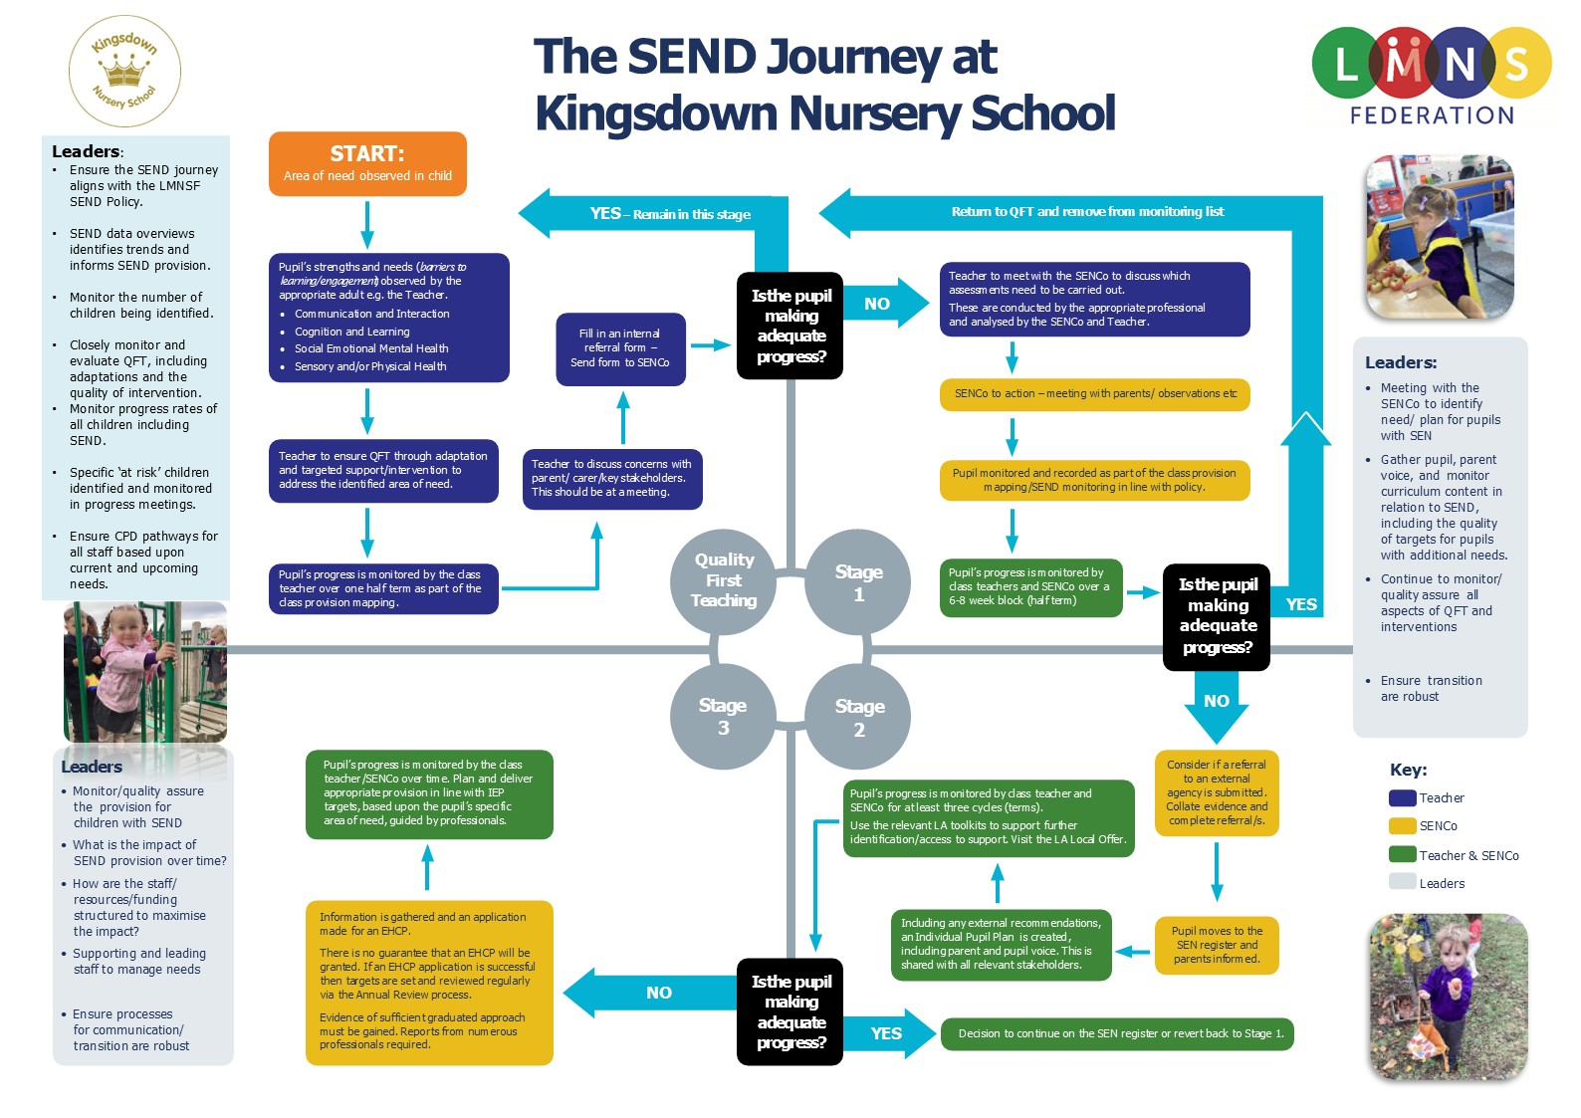

Slide 7
Early Identification
We notice if a child finds something tricky early on.
If your child needs more help, our SENCo will support you and the staff.
We talk to parents quickly so we can help straight away.
We are here to help

Slide 8
Four Areas of Need
1. Communication and Interaction
2. Cognition and Learning
3. Social, Emotional and Mental Health
4. Sensory or Physical Needs

Slide 9
Assess, Plan, Do, Review
We follow a simple cycle:
1. Assess – find out what your child needs.
2. Plan – decide what will help.
3. Do – put the support in place.
4. Review – see how it’s going and change if needed.

Slide 10
How we support children day-to-day
We use small groups, extra adult time, or special resources.
We make learning fun and hands-on.
We celebrate every little step forward!

Slide 11
How we work with you
Families know their children best so we will work with you every step of the way to capture your child’s voice and follow their strengths to help them make progress.
We will involve families in setting Smart Goals and invite you to share ideas that work well and celebrate progress.
We will share information about support services that you can access through the SEND Local Offer. SEND Local Offer – Lincolnshire County Council

Slide 12
How we include your child in everything
We make sure all children join in play and learning experiences both inside and outdoors.
Every child belongs at Kingsdown Nursery School.
We adapt activities so everyone can take part.

Slide 13
Staff training and expertise
Our staff learn new skills every year to support children with SEND. We received the Dingley's Promise Mark of Achievement in March 2025 as all our staff have completed the first 5 modules of the Early Years Inclusion Training
Staff are highly skilled and keep up to date with effective strategies that support children in all areas of SEND, working together with other professionals where appropriate.
We share what we learn with each other and our families through our SEND Padlet.

Slide 14
Working with outside experts
Sometimes, with your consent, we ask for help from specialists like:
Portage
Early learning and portage support service – Lincolnshire County Council
Speech and Language Therapists
Time to Play
Early Support Learning Provision | www.eyalliance.org.uk
Educational Psychologists
Early Years Specialist Teachers
Health Visitors
AskSALL – SEND Advice Line for Lincolnshire
SEND Advice Line for Lincolnshire (Ask SALL) – How to get help - Lincolnshire County Council

Slide 15
Supporting feelings and behaviour
We use a Total Communication Approach with Makaton Signs, Visual Aids and Speech to help children understand their feelings.
We have carefully designed our spaces, with natural materials, low lighting and plants to help children feel calm , regulated and ready to learn.
We celebrate diversity and teach children to be kind, share, and take turns with each other and respect each other’s differences.

Slide 16
Medical needs
Some children have Individual Health Plans to help keep them safe. These are written with families and regularly reviewed..
We work with families and professionals to meet the medical needs of the children in our care.
We follow the Equality Act 2010 to make any reasonable adjustments that are required to support children.

Slide 17
Education, Health and Care Plans
Some children need extra support through an EHCP.
Identifying and supporting SEND – What happens if there are still issues? - Lincolnshire County Council
An EHCP is a legal plan written by the Local Authority. Liaise will support families with any questions around the EHCP process.
Homepage – Liaise Lincolnshire
We support families through this process by completing the Education and Health Care Needs Assessment together through the EHC Hub.
https://ehchub.lincolnshire.gov.uk/

Slide 18
What to do if you’re unhappy or want to appeal
Please speak to Melissa Deen first.
We want to sort things out quickly and fairly.
You can also contact the Local Authority or SENDIASS.

Slide 19
Useful contacts
SENDCo and Head of School: Melissa Deen
Email: Melissa.deen@kingsdownnurseryschool.co.uk Phone: 01522 684335
Lincolnshire Local Offer: www.lincolnshire.gov.uk/send-local-offer
SENDIASS:
www.lincolnshire.gov.uk/sendiass

